Slide 1
Snowflake - Session
Day-6

Slide 2
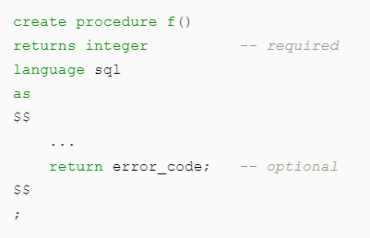
Stored Procedures
A stored procedure is created once and can be executed many times. A stored procedure is created with a CREATE PROCEDURE command and is executed with a CALL command.
Returning a Value from a Stored Procedure is Optional.
Stored procedures allow you to extend Snowflake SQL by combining it with JavaScript so that you can include programming constructs such as branching and looping.
Pseudo code:

Slide 3
Stored Procedures
You can write a stored procedure in one of the following languages:
Snowflake Scripting(SQL).
JavaScript
Python (using Snowpark)
Scala (using Snowpark)
Java (using Snowpark)
From a stored procedure, you can return a single value or (if you are using Snowflake Scripting) tabular data.

Slide 4
Stored Procedures
A typical stored procedure contains code similar to the following pseudo-code:
var my_sql_command1 = “DML Statement";
var statement1 = snowflake.createStatement(my_sql_command1);
statement1.execute();
This code uses an object named snowflake, which is a special object that exists without being declared. The object is provided inside the context of each stored procedure and exposes the API to allow you to interact with the server.
Benefits of Stored Procedures
Procedural logic (branching and looping), which straight SQL does not support.
Error handling.
Dynamically creating a SQL statement and execute it.

Slide 5
Stored Procedures
A stored procedure runs with either the caller’s rights or the owner’s rights. It cannot run with both at the same time.
A caller’s rights stored procedure runs with the privileges of the caller. The primary advantage of a caller’s rights stored procedure is that it can access information about that caller or about the caller’s current session. For example, a caller’s rights stored procedure can read the caller’s session variables and use them in a query.
An owner’s rights stored procedure runs mostly with the privileges of the stored procedure’s owner. The primary advantage of an owner’s rights stored procedure is that the owner can delegate specific administrative tasks, such as cleaning up old data, to another role without granting that role more general privileges, such as privileges to delete all data from a specific table.
At the time that the stored procedure is created, the creator specifies whether the procedure runs with owner’s rights or caller’s rights. The default is owner’s rights.
The owner can change the procedure from an owner’s rights stored procedure to a caller’s rights stored procedure (or vice-versa) by executing an ALTER PROCEDURE command.

Slide 6
Stored Procedures
Example:
CREATE OR REPLACE PROCEDURE emp_Proc(ID float, FNAME Varchar, LNAME Varchar)
returns string not null
language javascript
as
$$
var insert_stmt= `INSERT INTO EMP VALUES(:1,:2,:3)`
var sql_insert = snowflake.createStatement({sqlText:insert_stmt});
var sql_insert = snowflake.createStatement({ sqlText:insert_stmt, binds: [ID,FNAME,LNAME]});
sql_insert.execute();
return 'Sucess'
$$;

Slide 7
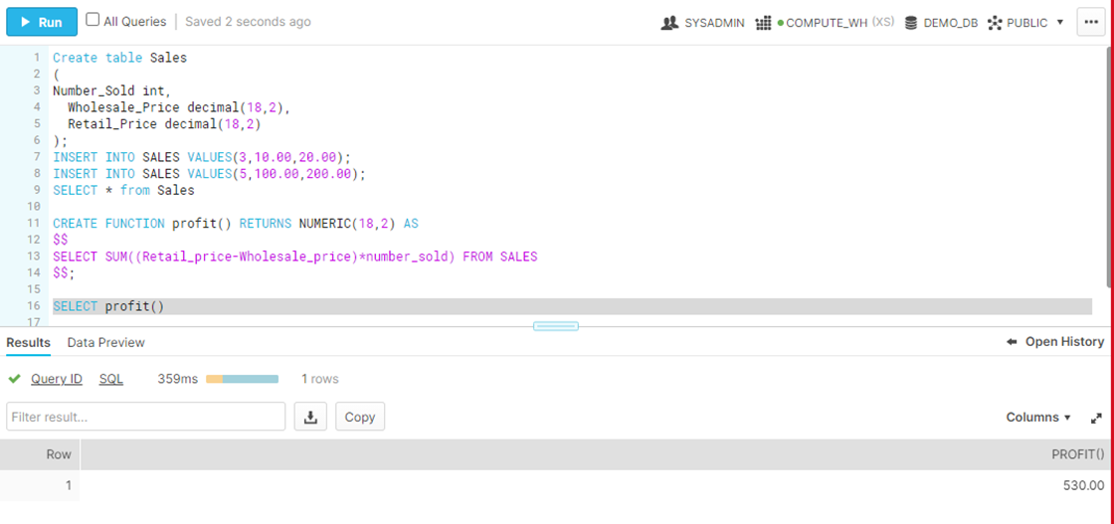
User-defined Functions
User-defined functions (UDFs) let you extend the system to perform operations that are not available through the built-in, system-defined functions provided by Snowflake. UDFs are currently available in Java, Javascript and SQL

Slide 8
User-defined Functions
SQL:
A SQL UDF can be either scalar or tabular.
A SQL UDF evaluates an arbitrary SQL expression and returns the result of the expression.
The expression can be either a general expression or a query expression:
This UDF uses the general expression pi() * radius * radius:
CREATE FUNCTION area_of_circle(radius FLOAT)
RETURNS FLOAT
AS
$$
pi() * radius * radius
$$
;
This UDF uses a query expression:
CREATE FUNCTION profit()
RETURNS NUMERIC(11, 2)
AS
$$
SELECT SUM((retail_price - wholesale_price) * number_sold)
FROM purchases
$$
;

Slide 9
User-defined Functions
create or replace function orders_for_product(prod_id varchar)
returns table (product_id varchar, quantity_sold numeric(11, 2))
as
$$
select product_id, quantity_sold
from orders
where product_id = prod_id
$$ ;
JavaScript:
JavaScript UDFs allow you to manipulate data using the JavaScript programming language and runtime environment. JavaScript UDFs are created in the same way as SQL UDFs, but with the LANGUAGE parameter set to JAVASCRIPT.
Similar to SQL UDFs, JavaScript UDFs can return either a scalar or a tabular result, depending on how the UDF is defined.
CREATE OR REPLACE FUNCTION add5(n double)
RETURNS double
LANGUAGE JAVASCRIPT
AS 'return N + 5;';
select add5(0.0);

Slide 10
Stored Procedures VS UDF
Stored Procedures | User Defined Functios
MAY return a value | MUST return a value
CANNOT return a set of rows | CAN return a set of rows(table)
Can access database objects and issue SQL statements | DDL and DML operations not permitted
Can run as function owner or caller Owner is default Specified at creation time | Runs as the function owner
Call my_procedure() | Select my_udf(()

Slide 11
Tasks
A task can execute a single SQL statement, including a call to a stored procedure.
Tasks can be combined with table streams for continuous ELT workflows to process recently changed table rows.
Streams ensure exactly once semantics for new or changed data in a table.
Tasks can be used independently to generate periodic reports by inserting or merging rows into a report table or perform other periodic work.
Syntax:
CREATE TASK <TASK_NAME>
WAREHOUSE = <WAREHOUSE>
SCHEDULE = '1 MINUTE' AS
INSERT INTO <Task_table(PARAMETERS)> VALUES(CURRENT_TIMESTAMP);

Slide 12
DAG of Tasks
a DAG is a visual representation of the sequence in which tasks should be executed based on their dependencies.
DAGs are particularly useful for representing workflows with complex task dependencies, as they provide a clear visual structure for understanding and managing the flow of tasks.
Significance of DAGs in Task Dependency Management:
DAGs play a crucial role in task dependency management, ensuring that tasks are executed in the correct sequence based on their dependencies.
In Snowflake, task dependencies determine the order in which tasks are executed, allowing for the proper flow of data and processing.
By visualizing task dependencies in a DAG, it becomes easier to understand the relationships between tasks and identify any potential bottlenecks or issues in the workflow.
DAGs enable efficient workflow management by providing a structured framework for organizing and orchestrating tasks.
Benefits of Using DAGs in Snowflake
Improved task sequencing and coordination.
Efficient management of task dependencies.
Enhanced workflow visualization and monitoring.

Slide 13
DAG of Tasks
Representation of Task Dependencies in Snowflake Workflows:
In Snowflake, task dependencies are established by specifying the order in which tasks should be executed.
Tasks can depend on one or more preceding tasks, ensuring that the dependent task(s) execute only after their dependencies have completed successfully.
Snowflake provides mechanisms for defining task dependencies using SQL statements, stored procedures, or task chaining techniques.
These dependencies can be represented in a DAG format, where each task is a node, and the directed edges depict the dependencies between tasks.
Visualizing task dependencies in a DAG helps users understand the flow of tasks and ensure that the workflow is structured correctly.
DAGs are a valuable tool for managing task dependencies in Snowflake workflows. They provide a visual representation of the sequencing and relationships between tasks, enabling efficient execution and coordination of complex data processing pipelines..

Slide 14
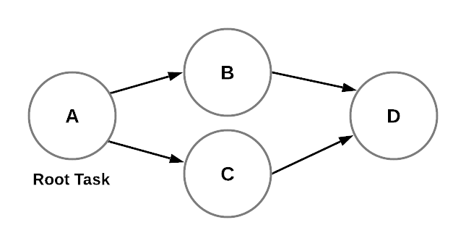
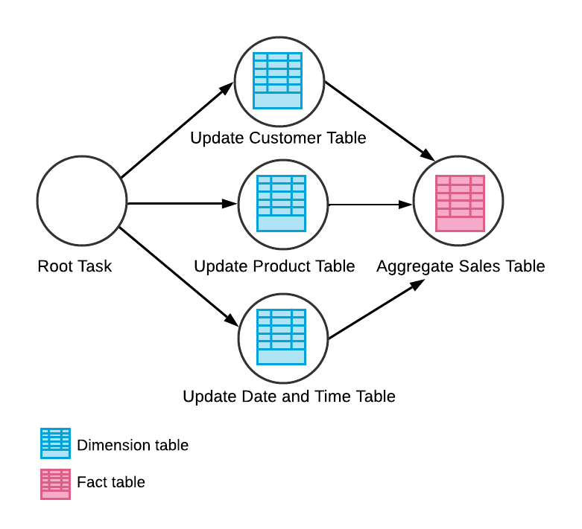
DAG of Tasks

Slide 15
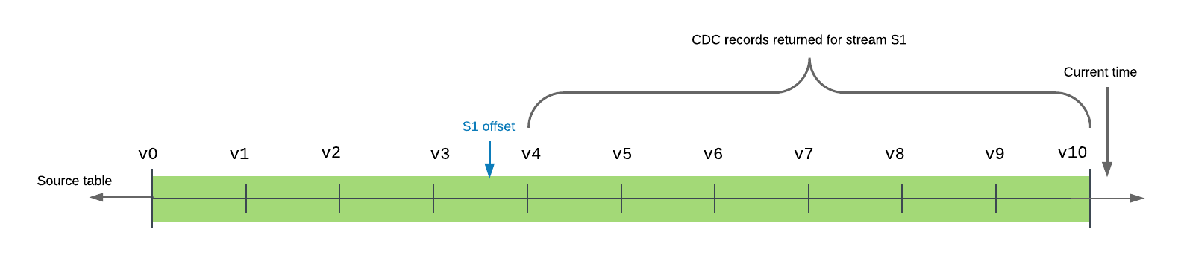
Streams
Streams are Snowflake native objects that manage offsets to track data changes for a given object (Table or View).
Two types of Streams:
Standard : A Standard Stream can track all DML operations
Append-Only: Append-Only streams can only track INSERT operations.

Slide 16
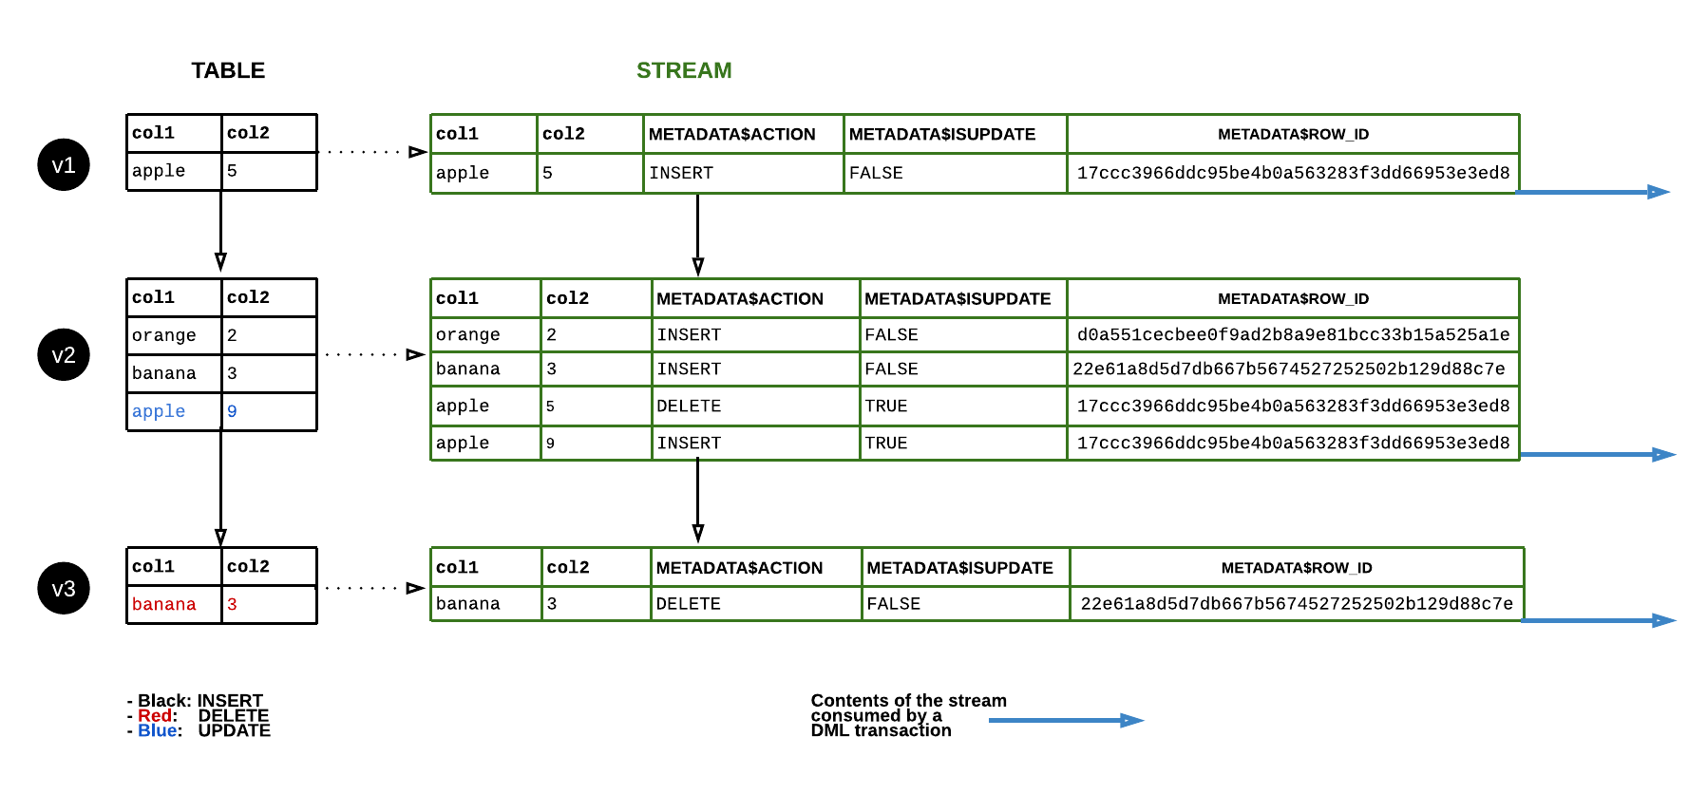
Streams

Slide 17
Streams
SYNTAX: CREATE [ OR REPLACE ] STREAM [IF NOT EXISTS] <name>
[ COPY GRANTS ] ON TABLE <table_name> [ { AT | BEFORE }
{ TIMESTAMP => <timestamp> | OFFSET => <time_difference> | STATEMENT => <id> } ] [ APPEND_ONLY = TRUE | FALSE ]
[ SHOW_INITIAL_ROWS = TRUE | FALSE ] [ COMMENT = '<string_literal>' ]

Slide 18
Sequences
They are used to generate unique numbers across sessions and statements, including concurrent statements.
They can be used to generate values for a primary key or any column that requires a unique value.
We need to note that Snowflake does not guarantee generating sequence numbers with no gaps.
The Sequences will wrap around after reaching the maximum positive integer value for the data type.

Slide 19
Sequences
Example 1:
create or replace sequence seq_01 start = 1 increment = 1;
select seq_01.nextval;
Example 2:
create or replace sequence seq_5 start = 1 increment = 5;
select seq_5.nextval a, seq_5.nextval b, seq_5.nextval c, seq_5.nextval d;

